Slide 1
Looping
Form is:
do i = 1, 10
...
end do
do i = 1, 10, 2
...
end do
The first loops from 1 to 10
The second loops from 1 to 10, but odd numbers only

Slide 2
Loop control
Exit
Exits the loop, not the program
Cycle
Similar to next or continue in other languages
Starts the next iteration of the loop

Slide 3
Demo program
! This program allows the user to input the number of degrees in an angle
! and then computes the cosine, sine, and tangent. It continues until the
! user inputs "n" or "N".
PROGRAM angle
IMPLICIT none
! Type variables.
REAL :: cosine, sine, tangent, degrees
REAL :: pi = 3.141592
CHARACTER :: choice
DO
! Enter and read the number of degrees in the angle.
PRINT *, "Enter the number of degrees in the angle."
READ *, degrees
! Convert number of degrees in angle to radians.
degrees = degrees*(pi/180)
! Use intrinsic functions to compute values.
cosine=cos(degrees)
sine=sin(degrees)
tangent=tan(degrees)
! Print results.
PRINT *, "cosine=", cosine, " sine=", sine, " tangent=", tangent
! Give user chance to exit program.
PRINT *
PRINT *, "Would you like to do this again?"
PRINT *,"(Press n to exit - any other key to continue.)"
READ *, choice
! Exit loop if the value in choice is N or n.
IF (choice == "N" .or. choice == "n") EXIT
END DO
STOP
END PROGRAM angle
Computes the sin, cos, tan, etc.

Slide 4
Demo program
! This program averages a series of numbers input
! from the keyboard.
PROGRAM average
IMPLICIT none
! Type variables.
REAL :: data, sum, avg
INTEGER num, i
! Prompt for and enter number of numbers to average.
PRINT *,"Enter the number of numbers to average."
READ *,num
sum = 0.0
! Loop goes from 1 to number of values to average.
DO i = 1, num
! Prompt for and enter a number.
PRINT *,"Enter a value for the number"
READ *,data
! Add number to total.
sum = sum + data
END DO
! Calculate average.
avg = sum/real(num)
! Print results.
PRINT *,"The average = ",avg
STOP
END
Computes the average

Slide 5
Demo program
! This program uses a function to find the average of three numbers.
PROGRAM func_ave
! Type variables in main program (a, b, and c are local variables).
REAL :: a,b,c,average
! Prompt for and get numbers to be averaged.
PRINT *,"Enter the three numbers to be averaged."
READ *, a,b,c
! Invoke function average
PRINT *,"The three numbers to be averaged are ",a,b,c
PRINT *,"The average of the three numbers is ", average(a,b,c)
STOP
END PROGRAM func_ave
! Function average
REAL FUNCTION average(x,y,z)
! Type variables in function (x, y, and z are local varialbes).
REAL :: x,y,z
! Function name contains the average the function calculates and returns.
average = (x + y + z)/3.0
RETURN
END FUNCTION average
Computes the average via a defined function

Slide 6
Fortran gotchas
All variables must be declared at the beginning
Remember line limit of 72 characters!
Consider:
The 8th variable is named ‘ei’
There is no 9th variable declared
No continuation lines in Fortran 77
== is comparison for if's
Can’t seem to be able to change the values of parameters in functions
integer :: first, second, third, fourth, fifth, sixth, seventh, eighth, ninth
Column 72!

Slide 7
End of lecture on 29 Aug 2005
Next 3 slides gone over a few days later

Slide 8
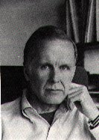
John Backus
Chemistry major at UVA (entered 1943)
Flunked out after second semester
Joined IBM as programmer in 1950
Developed Fortran, first commercially successful programming language and compiler

Slide 9
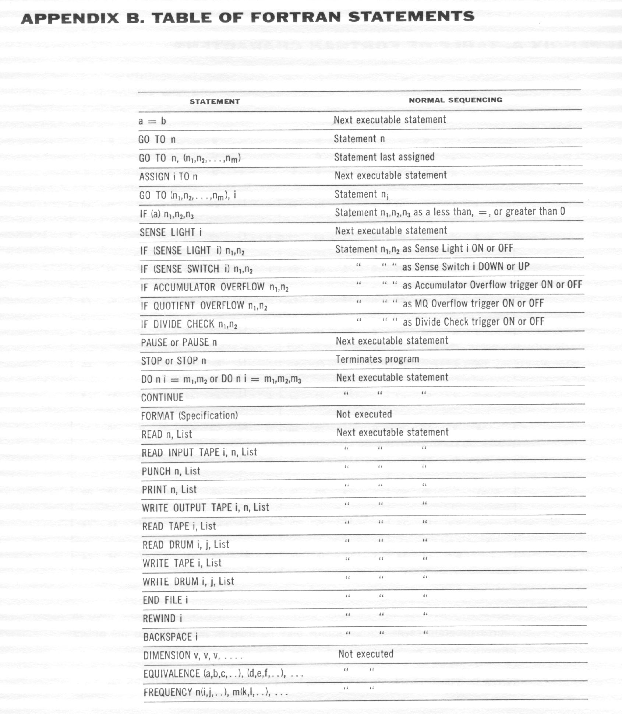
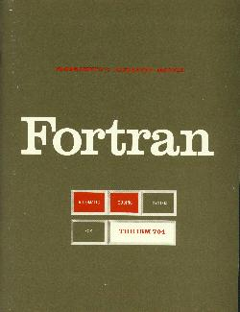
IBM 704 Fortran manual, 1956

Slide 10
Fortran issues…
Fortran language was described using English
Imprecise
Verbose, lots to read
Ad hoc
DO 10 I=1.10
Assigns 1.10 to the variable DO10I
Early Fortrans didn’t care about spaces!
DO 10 I=1,10
Loops for I = 1 to 10
(Often incorrectly blamed for loss of Mariner-I)

